Slide 1

Varendra University
Dept. of Computer Science & Engineering (CSE)
Lab 4
Course Title: Microprocessor and Assembly Language Lab
Course No: CSE 3206
Prepared By:
Md. Adnan Sami
Lecturer, Dept. of CSE, VU

Slide 2
Experiment No: 04
Name of the Experiment:
    Write an assembly language program to print the letters A to Z using EMU8086.
    Write an assembly language program to display a row of 80 stars using EMU8086.
    Write an assembly language program to print a 5 × 5 matrix using EMU8086.

Slide 3
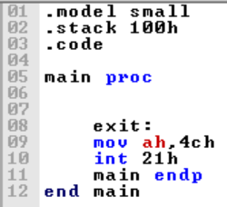
  Return

Slide 4
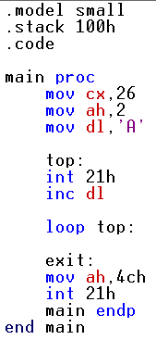
  2. Write some code in assembly language for printing A-Z using EMU8086.
Notes:
s

Slide 5
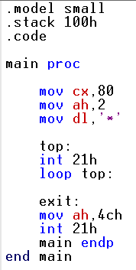
    2. Write some code in assembly language for displaying a row of 80 stars using EMU8086.

Slide 6
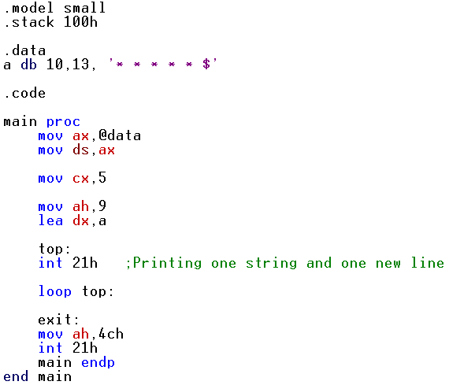
    3. Write an assembly language program to print a 5 × 5 matrix using EMU8086.

